Slide 1
Packaging Your Code
Creating your own Meteorite Smart Packages

Slide 2
What is a Meteorite Package?
Similar concept to:
  Ruby → Gem, Python → Python Package, Node → Packaged Module.
Reusable pattern
Abstracted project logic for specific task.

Slide 3

Installation & Usage
npm install -g meteorite
mrt add router

Slide 4
What already exists?
mrt add bootstrap
mrt add router
mrt add spin
More hosted at: https://atmosphere.meteor.com/

Slide 5
Should I make this a Package?
Does it already exist?
Can it be generalized? Can other projects use the same code?
Do I want to be a maintainer?

Slide 6
Example: Crowd-Fundr

Slide 7
Example: Crowd-Fundr
Site for proposing projects
Requires Paypal for processing card authorizations.
Should eventually use several payment gateways.
Cannot store card data (PCI Compliance)

Slide 8
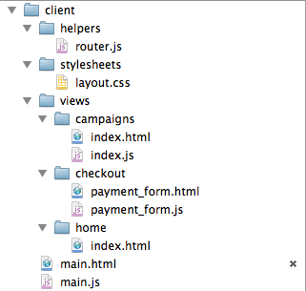
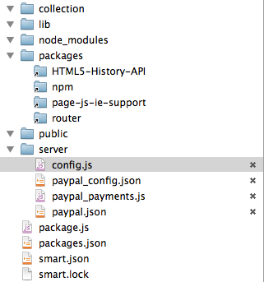
Structure

Slide 9
Why write it multiple times?
No one wants to code that more than once.
Coding from scratch is fun once.
Don't Copy/Paste code.

Slide 10
Code Needed
Credit Card Form:
  Name on card, Number, Expiration Date, CVV
Parsing user and payment data into JSON.
Include node paypal_sdk package.
Process payment and fire callback. (Future)

Slide 11
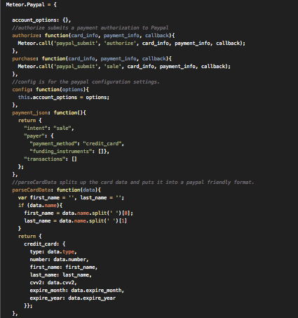
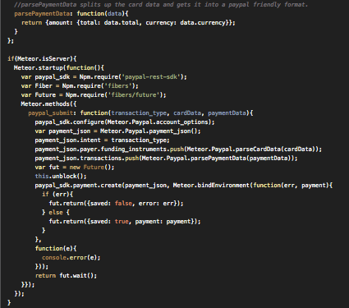
Lets see it!

Slide 12
Creating a Package

Slide 13
Creating a Package: Directory
Create a directory in packages:
  mkdir packages/meteor-paypal

Slide 14

Creating a Package: Package.js
Create a package.js file in the directory.
  touch packages/meteor-paypal/package.js
Add a description.

Slide 15
Meat and Potatoes
Package.on_use method sets up the package data.
  use: add external packages
  add_files: tell what files to include in the package.
  export: name of the package. Will be accessible via Meteor.(package name)

Slide 16
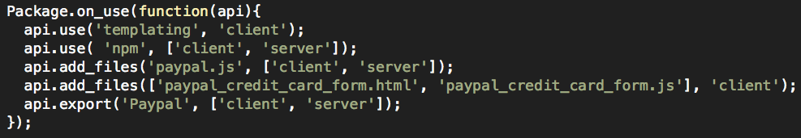
Example on_use

Slide 17
Using NPM
NPM dependencies are easy to add.
Requires specific version.

Slide 18
Moving Code into the Package

Slide 19
Package Structure
Just like a regular project.
  Multiple files, directories, etc.

Slide 20
Namespacing
In single project: object is Paypal
In package: object is Meteor.Paypal
  Specified in the api.export method

Slide 21
Deploying Package

Slide 22
Deploying Package: smart.json
smart.json file required for deployment
Json file describing package:
  name → the package name
  description → a short description of the package.
  homepage → A link to a homepage (usually the github repo)
  author → who to attribute this package to
  version → version of this package (period delimited) (see http://en.wikipedia.org/wiki/Software_versioning for examples)
  git → git repo. (usually github)
  packages → hash of packages required in this package

Slide 23
Deploying Package: releasing
Create account on Atmosphere:
  https://atmosphere.meteor.com/
Use mrt release to deploy inside package root
  mrt release .

Slide 24
Lastly: Verify Functionality
Remove old files and code.
Replace calls to original object with new Meteor calls:
  Paypal.authorize() → Meteor.Paypal.authorize()

Slide 25
Conclusion
Thanks to Phil (@phillyqueso) and the rest of the team at TasteMade (@tastemade) for their help with the project.
Thanks to the Austin Meteor Meetup for letting me present this.

Slide 26
Resources
Atmosphere: https://atmosphere.meteor.com/
Meteor Docs: http://docs.meteor.com/#writingpackages
Google: https://www.google.com/

